Slide 1
Inpainting with SinGANs
Megi Dervishi
Deep Learning course - MVA
Ecole Normale Superieure - ULM

Slide 2

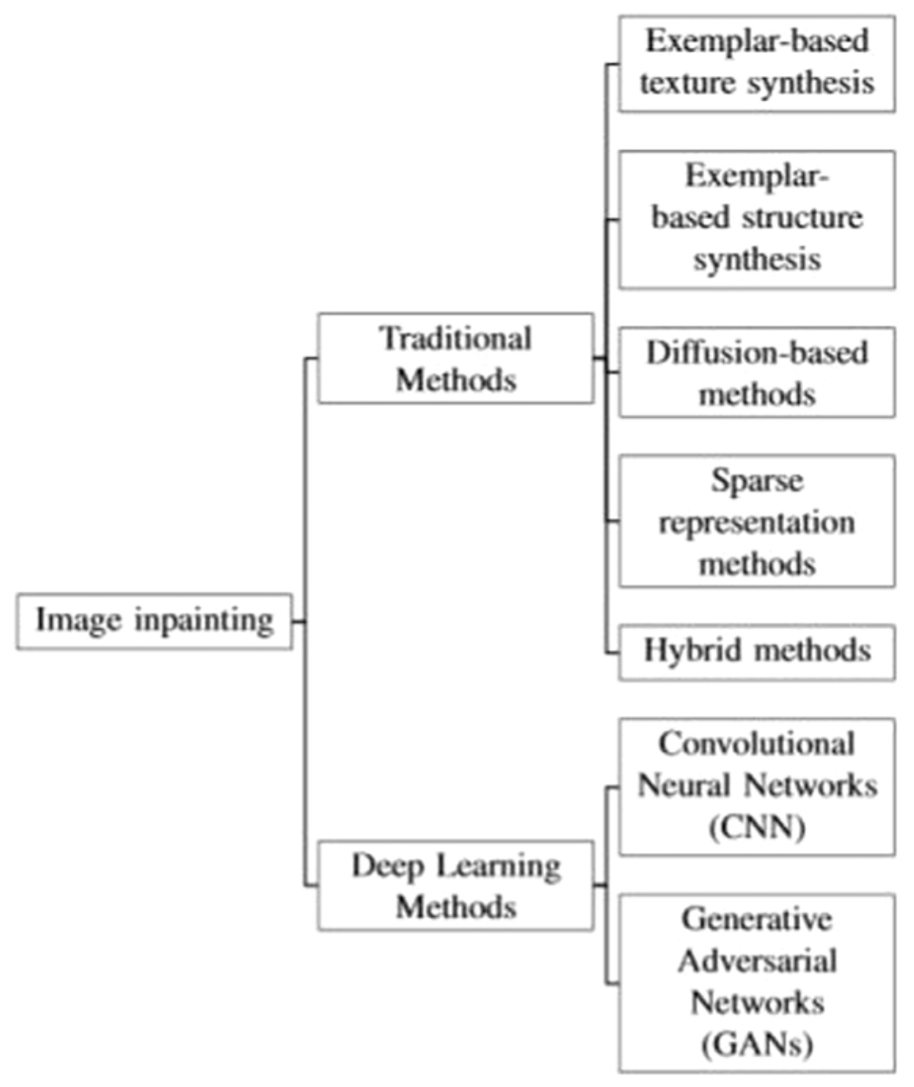
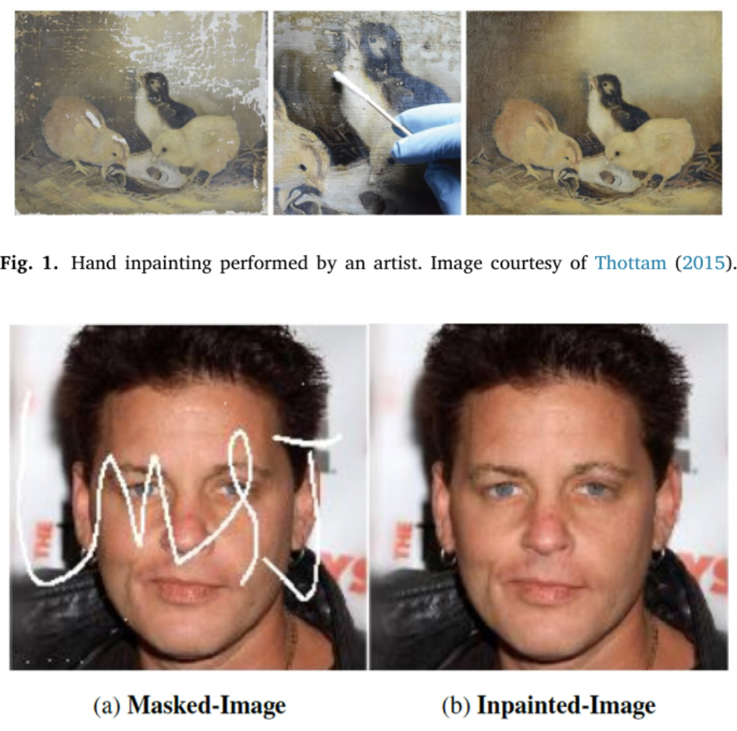
Introduction & Motivation
Inpainting
Single Generative
Adverserial
Networks
😃
Too much data
😩

Slide 3
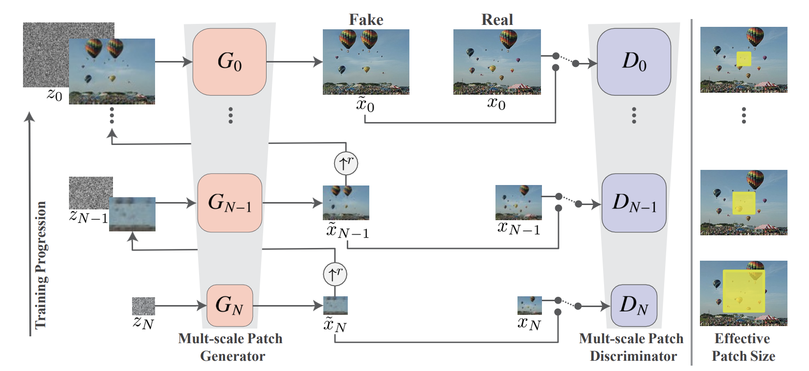
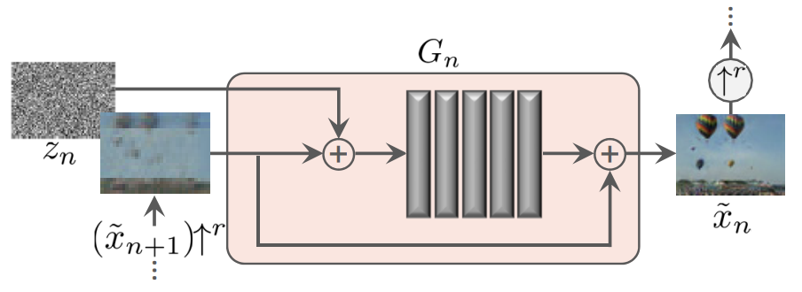
What are SinGANs?
Image Manipulation Tasks.
1. Random Sampling
2. Editing
3. Harmonization
4. Paint2Image
5. Animation
Evaluate SinGANs on such tasks for different types of images.

Slide 4
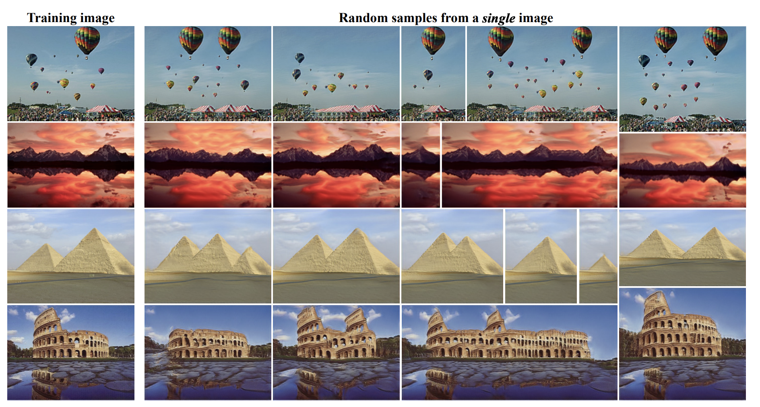
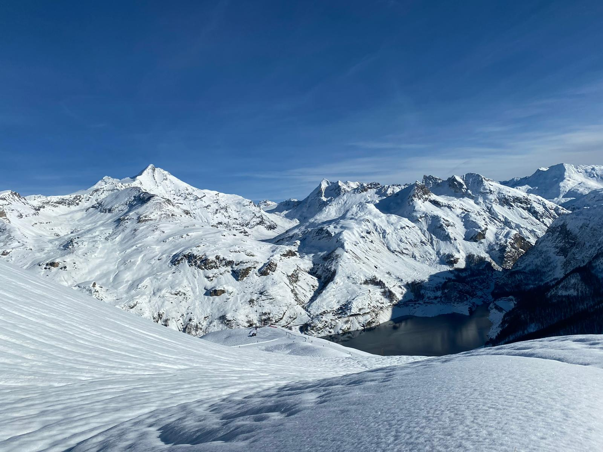
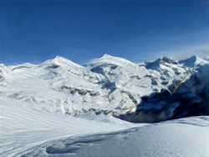
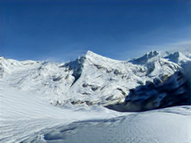
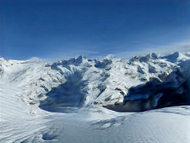
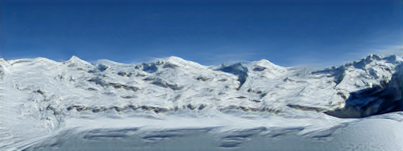
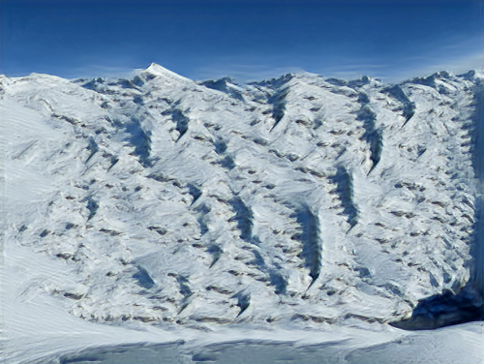
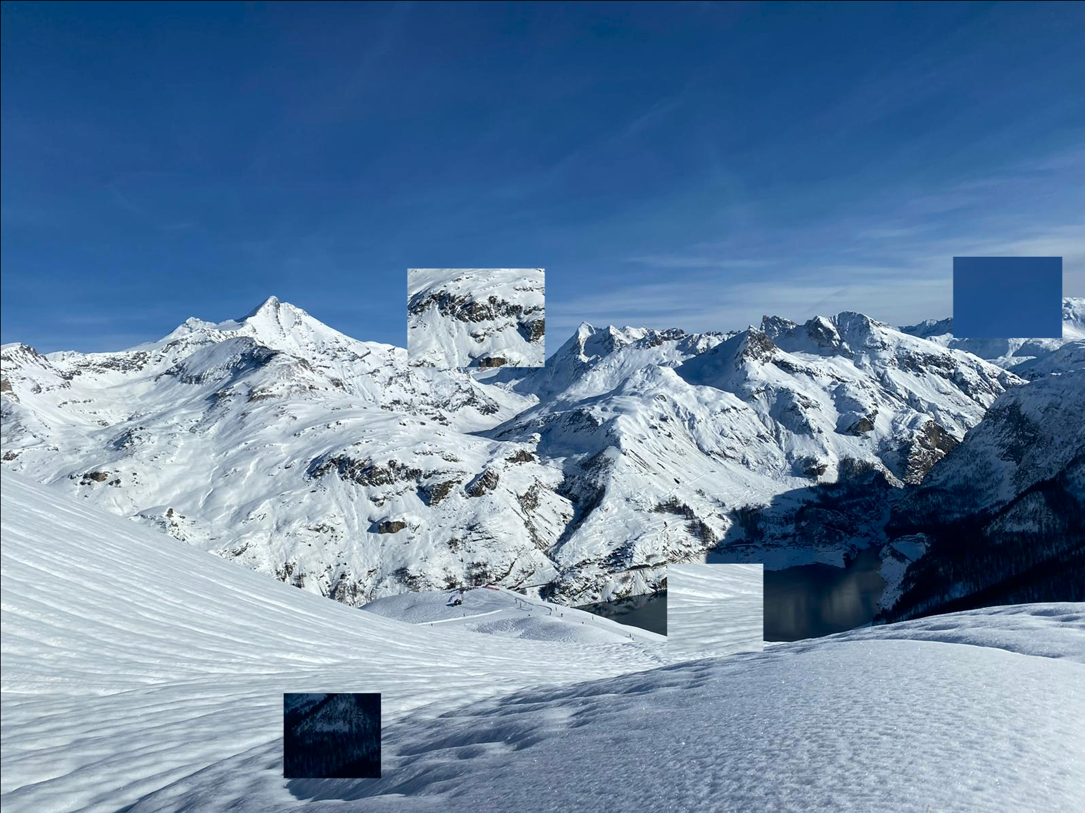
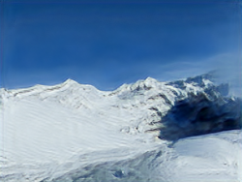
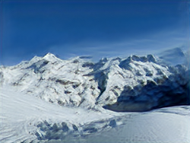
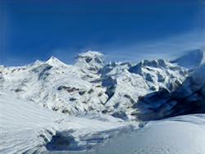
Results
1. Random Sampling
Input edited image
Generated image
2. Editing

Slide 5
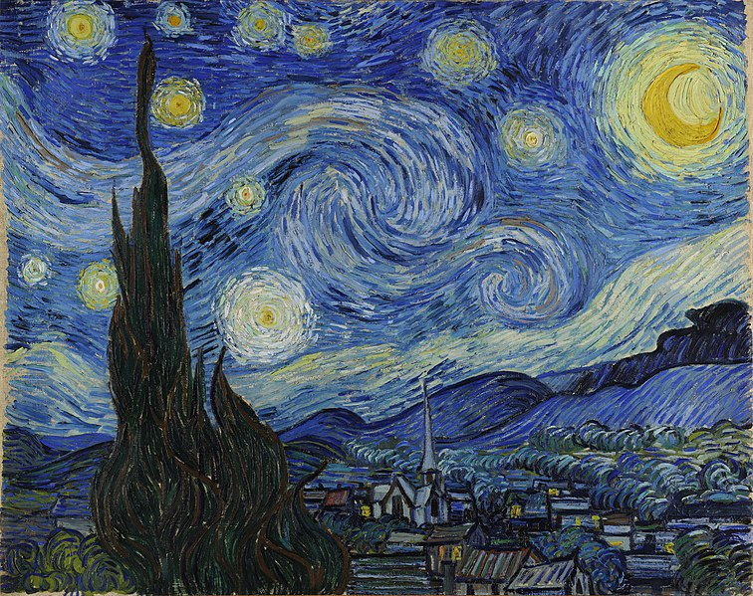
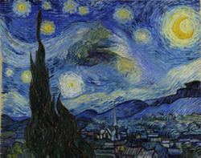
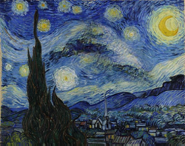
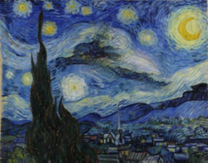

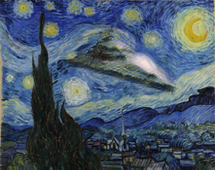
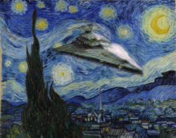
Results
Trained image
Generated image
3. Harmonization
4. Animation

Slide 6
InPainting
Patch filling
Complexity of the background
Shape of the patch

Slide 7
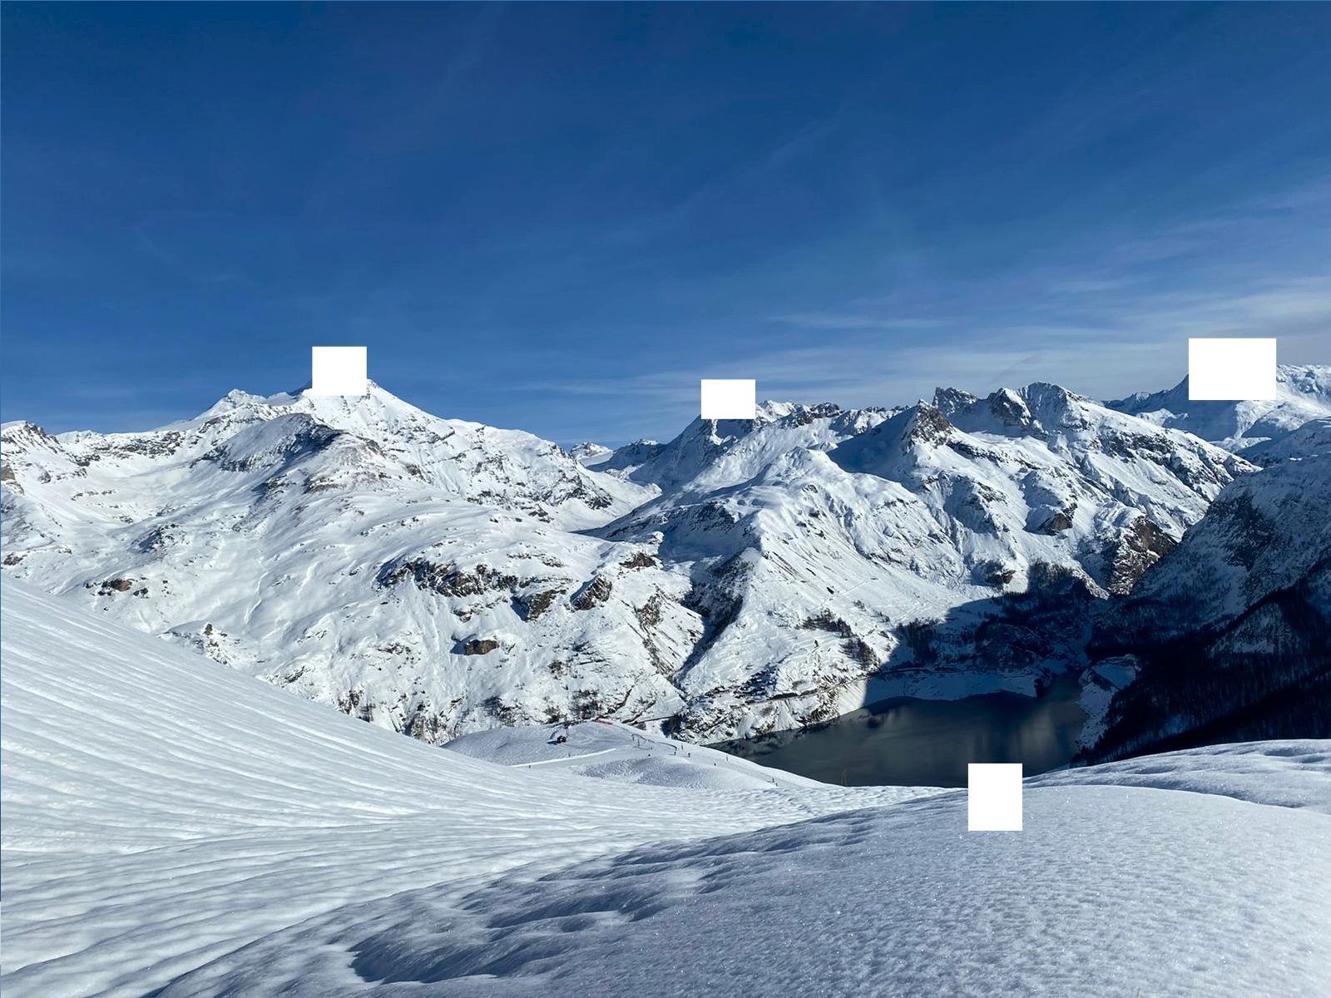
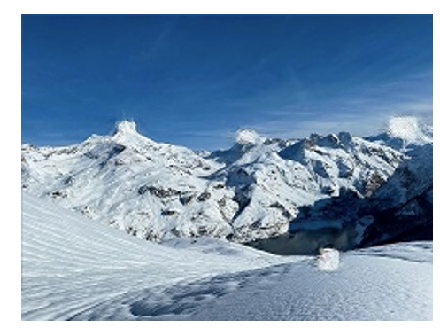
InPainting
Patch filling
Complexity of the background
Shape of the patch
Naïve Filling

Slide 8
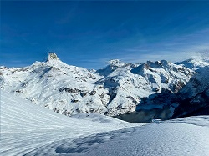
InPainting
Patch filling
Complexity of the background
Shape of the patch
Average color
Filling

Slide 9
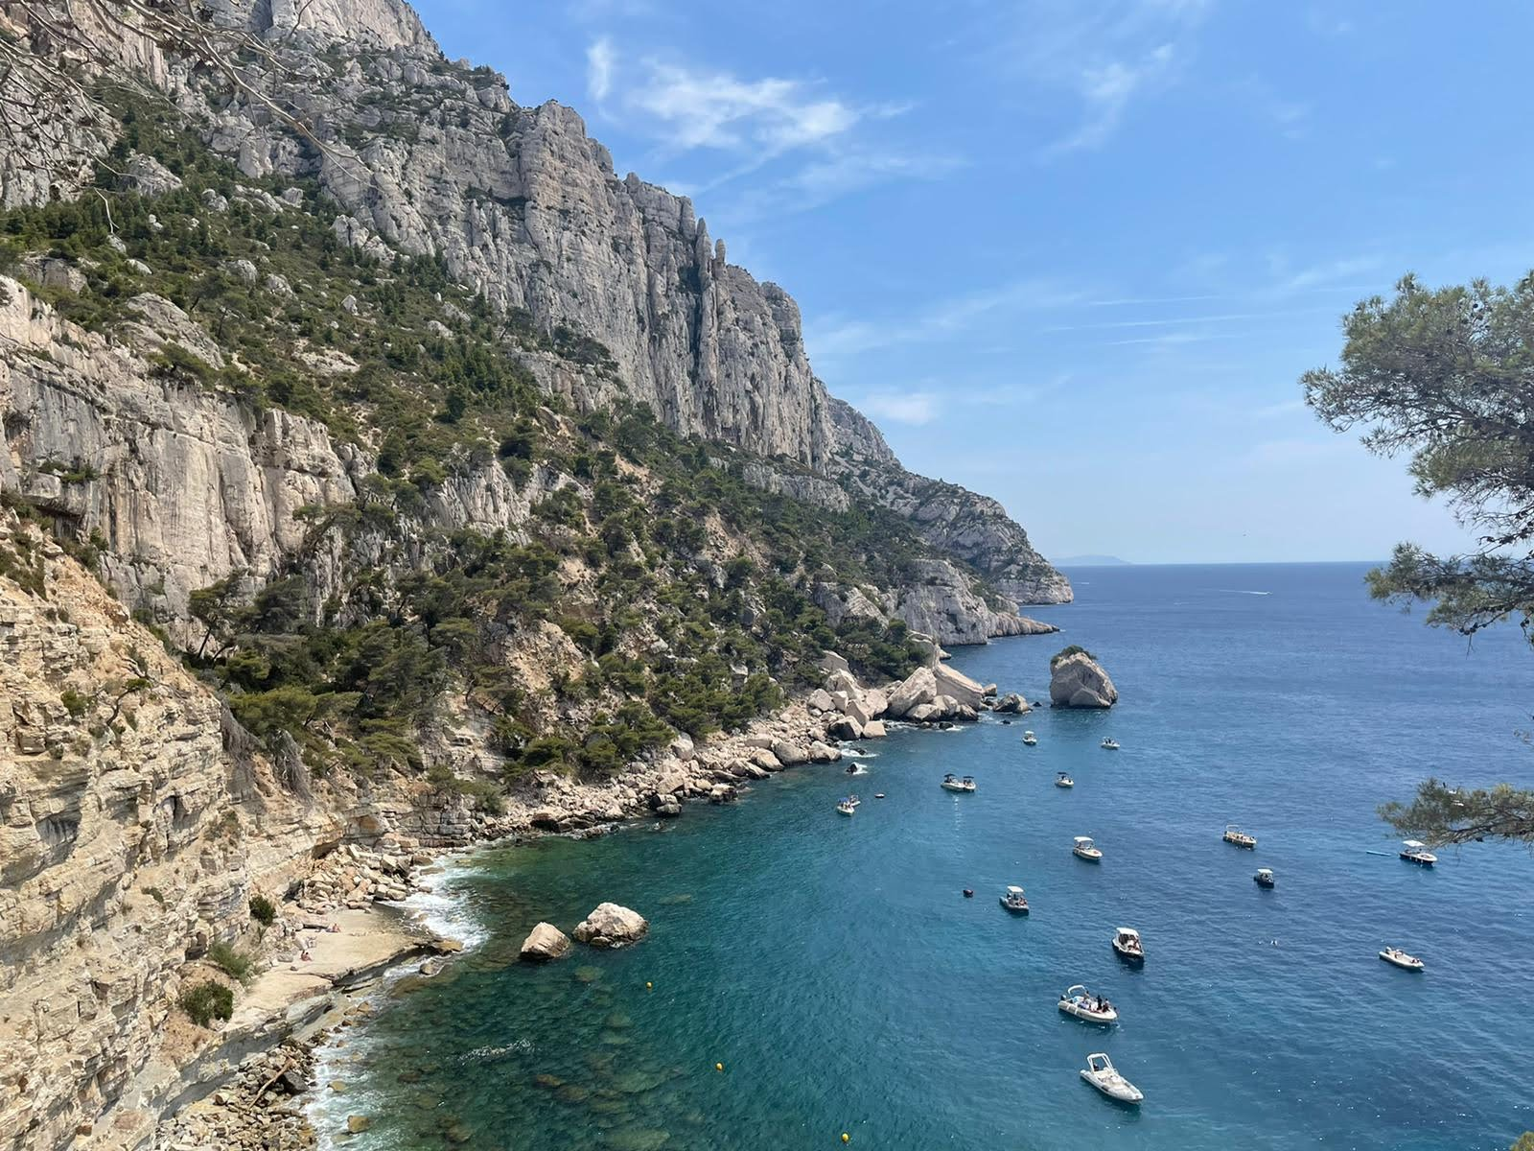
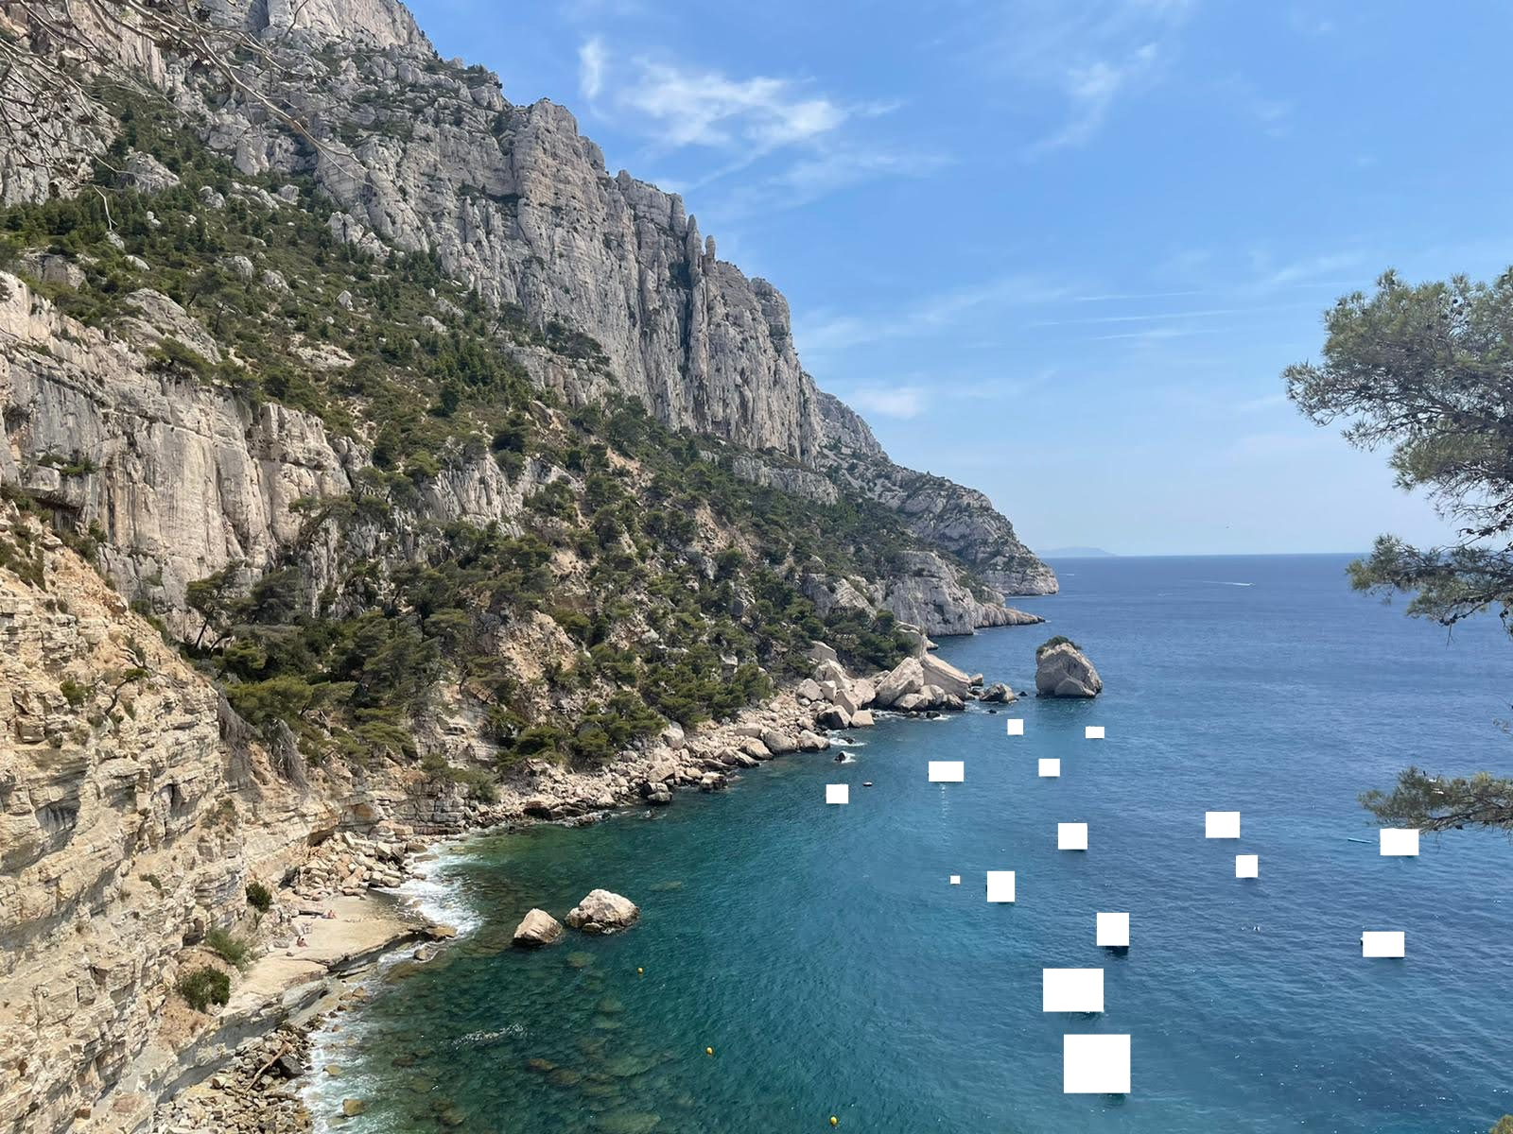
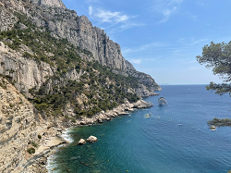
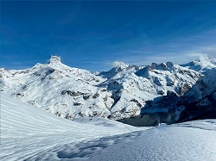
InPainting
Patch filling
Complexity of the background
Shape of the patch
Uniform
Complex

Slide 10
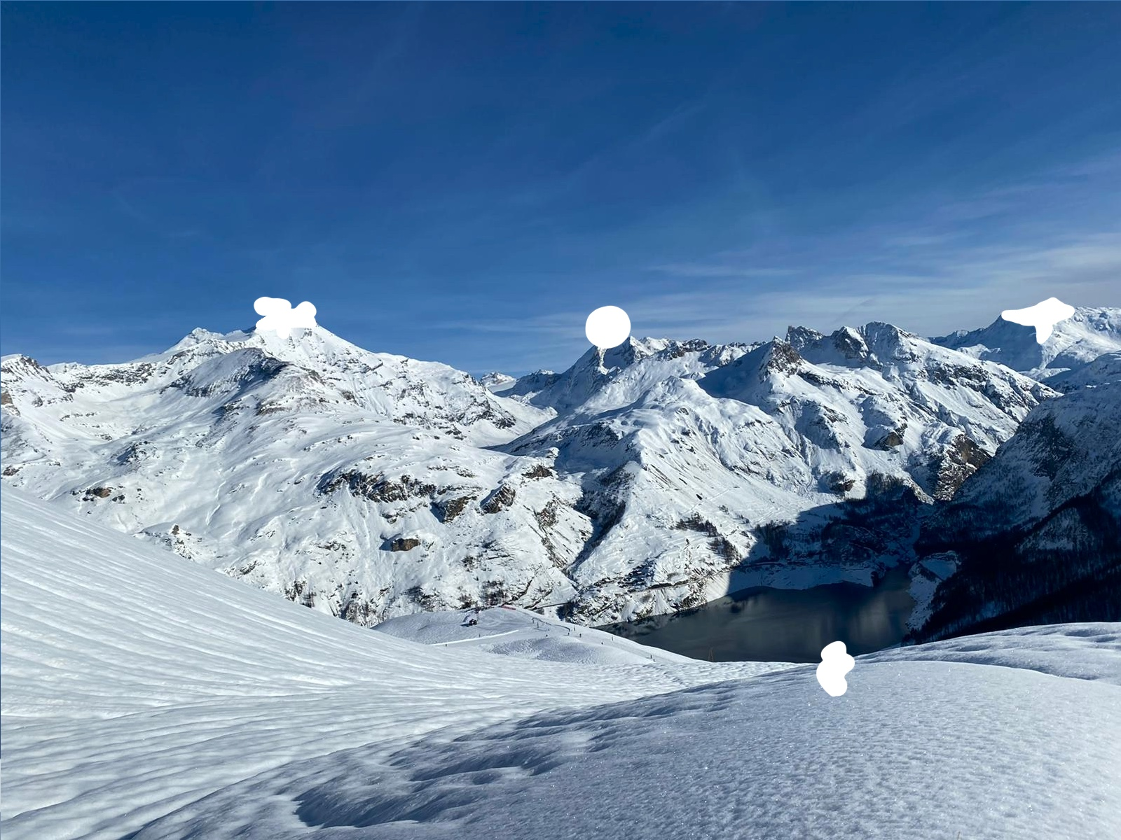
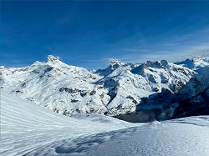
InPainting
Patch filling
Complexity of the background
Shape of the patch
Regular
Irregular

Slide 11
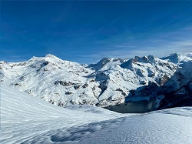
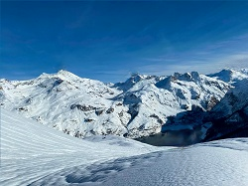
InPainting
Patch filling
Complexity of the background
Shape of the patch
FMM filling

Slide 12
Conclusion & Improvements
Reproduced the key results (qualitatively and quantitatively) of the SinGAN paper.
Implemented Inpainting with SinGAN
Studied the performance of SinGAN Inpainting
Improve: Iterative Inpainting
Thank you for your attention!

